Slide 1
Advanced Artificial Intelligence
Week #7
Dr. Qurat Ul Ain
Assistant Professor Dept. of AI & DS
FAST NUCES, Islamabad
Email: quratul.ain@isb.nu.edu.pk

Slide 2
Prediction Problems: Classification vs. Numeric Prediction
Classification
predicts categorical class labels (discrete or nominal)
classifies data (constructs a model) based on the training set and the values (class labels) in a classifying attribute and uses it in classifying new data
Numeric Prediction
models continuous-valued functions, i.e., predicts unknown or missing values
Typical applications
Credit/loan approval:
Medical diagnosis: if a tumor is cancerous or benign
Fraud detection: if a transaction is fraudulent
Web page categorization: which category it is

Slide 3
Classification—A Two-Step Process
Model construction: describing a set of predetermined classes
Each tuple/sample is assumed to belong to a predefined class, as determined by the class label attribute
The set of tuples used for model construction is training set
The model is represented as classification rules, decision trees, or mathematical formulae
Model usage: for classifying future or unknown objects
Estimate accuracy of the model
The known label of test sample is compared with the classified result from the model
Accuracy rate is the percentage of test set samples that are correctly classified by the model
Test set is independent of training set (otherwise overfitting)
If the accuracy is acceptable, use the model to classify new data
Note: If the test set is used to select models, it is called validation (test) set

Slide 4
Process (1): Model Construction
Classification
Algorithms
Training
Data
Classifier
(Model)
IF rank = ‘professor’
OR years > 6
THEN tenured = ‘yes’

Slide 5
Process (2): Using the Model in Prediction
Classifier
Testing
Data
Unseen Data
(Jeff, Professor, 4)
Tenured?

Slide 6
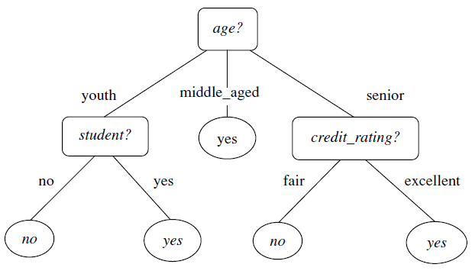
Decision Tree
A decision tree is a flowchart-like tree structure, where each Internal node (non leaf node) denotes a test on an attribute (denoted by rectangles).
Each branch represents an outcome of the test
Each leaf node (or terminal node) holds a class label (denoted by ovals).
The topmost node in a tree is the root node.

Slide 7
How are decision trees used for classification?
Given a tuple, X, for which the associated class label is unknown, the attribute values of the tuple are tested against the decision tree.
A path is traced from the root to a leaf node, which holds the class prediction for that tuple.
Decision trees can easily be converted to classification rules.

Slide 8
Decision Tree Induction: An Example
Training data set: Buys_computer
The data set follows an example of Quinlan’s ID3 (Playing Tennis)
Resulting tree:
age?
<=30
overcast
>40
31..40
student?
yes
credit rating?
no
yes
excellent
fair
no
yes
no
yes

Slide 9
Attribute Selection Measure: Information Gain (ID3/C4.5)
Select the attribute with the highest information gain
Let p_{i} be the probability that an arbitrary tuple in D belongs to class C_{i}, estimated by |C_{i, D}|/|D|
Expected information (entropy) needed to classify a tuple in D:
Information needed (after using A to split D into v partitions) to classify D:
Information gained by branching on attribute A
Notes:
I : the expected information needed to classify a given sample
E (entropy) : expected information based on the partitioning into subsets by A

Slide 10
Attribute Selection Measure:
Entropy vs Information Gain
Entropy is used as a criterion to measure the impurity of a node in a decision tree.
A node with high entropy indicates that the class labels of the data in that node are mixed or uncertain, while a node with low entropy indicates that the class labels are mostly homogeneous or certain.
The decision tree algorithm tries to minimize the entropy of the nodes as much as possible while constructing the tree, so that the resulting tree can make accurate predictions.
Notes:
I : the expected information needed to classify a given sample
E (entropy) : expected information based on the partitioning into subsets by A

Slide 11
Attribute Selection Measure:
Entropy
Entropy is a metric to measure the impurity in a given attribute. It specifies randomness in data. Entropy can be calculated as:
Entropy(s)= -P(yes)log2 P(yes)- P(no) log2 P(no)Where,
S= Total number of samples
P(yes)= probability of yes
P(no)= probability of no
Notes:
I : the expected information needed to classify a given sample
E (entropy) : expected information based on the partitioning into subsets by A

Slide 12
Attribute Selection Measure:
Entropy vs Information Gain
Information gain, on the other hand, is used to determine which attribute or feature should be chosen for splitting the data at each node of the tree.
The attribute or feature that provides the highest information gain is chosen as the splitting criterion, as it allows for the most reduction in uncertainty or entropy in the resulting child nodes. I
In other words, information gain helps the decision tree algorithm decide which attribute or feature is the most informative in terms of predicting the class labels of the data.
Notes:
I : the expected information needed to classify a given sample
E (entropy) : expected information based on the partitioning into subsets by A

Slide 13
Attribute Selection: Information Gain
Class P: buys_computer = “yes”
Class N: buys_computer = “no”
means “age <=30” has 5 out of 14 samples, with 2 yes’es and 3 no’s. Hence
Similarly,

Slide 14
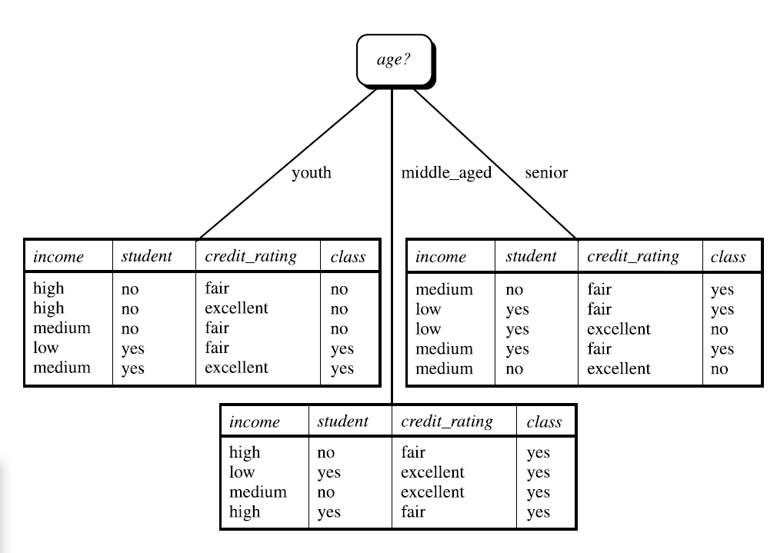
Attribute Selection: Information Gain

Slide 15
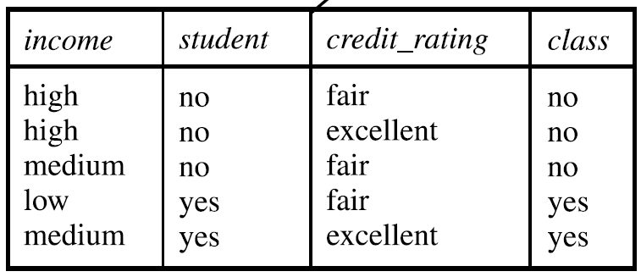
Attribute Selection: Information Gain

Slide 16
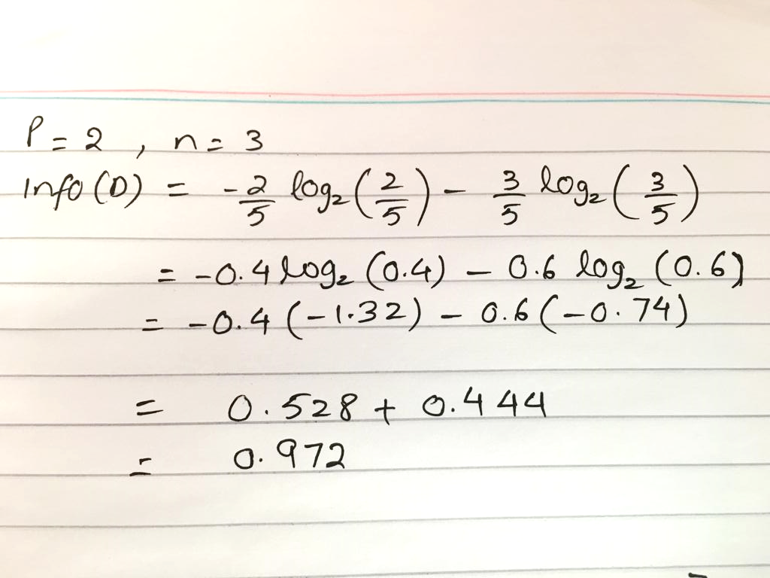
Attribute Selection: Information Gain

Slide 17
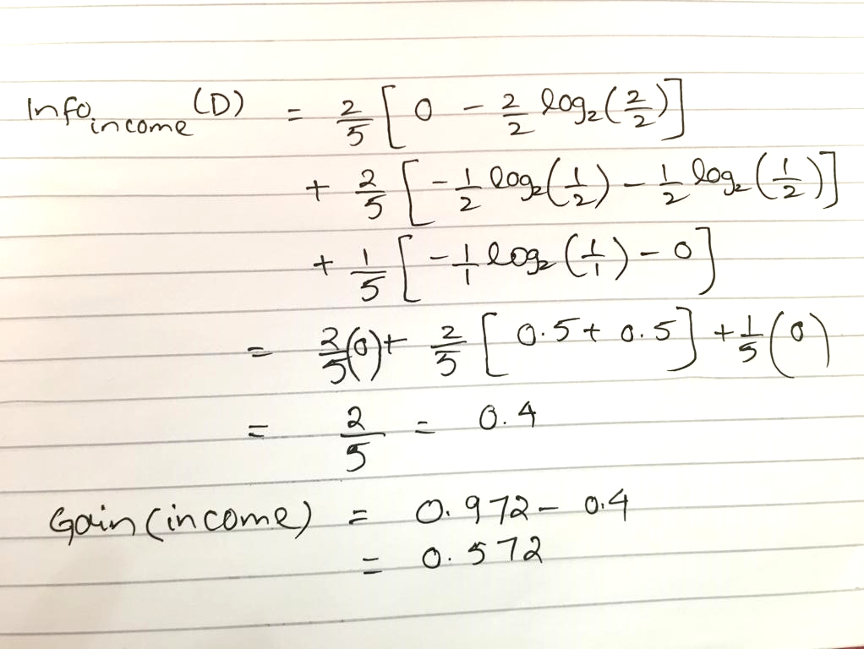
Attribute Selection: Information Gain

Slide 18
Attribute Selection: Information Gain
Gain (Student) = 0.972
Gain (Credit-Rating) = 0.032
Gain ( Income ) = 0.572
Which attribute should be used as a splitting attribute for this table?

Slide 19
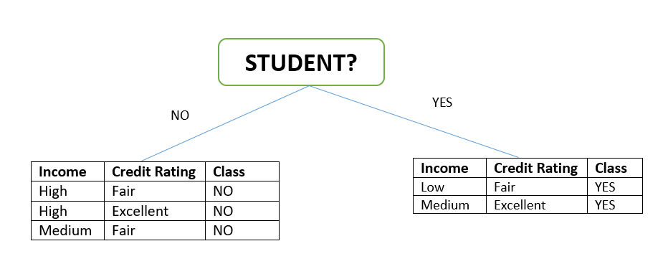
Internal Nodes & Leaf Nodes

Slide 20
Resultant Tree
age?
<=30
overcast
>40
31..40
student?
yes
credit rating?
no
yes
excellent
fair
no
yes
no
yes
Decision trees do not necessarily cover all attributes (Like Income) in a dataset.
Notes:
Decision trees do not guarantee usage of all attributes; they focus on selecting attributes that maximize splitting efficiency (e.g., reducing impurity). Irrelevant, redundant, or less important attributes may be skipped during tree construction.

Slide 21
Pruning: Getting An Optimal Decision Tree
Pruning is a process of deleting the unnecessary nodes from a tree in order to get the optimal decision tree.
A too-large tree increases the risk of overfitting, and a small tree may not capture all the important features of the dataset. Therefore, a technique that decreases the size of the learning tree without reducing accuracy is known as Pruning. There are mainly two types of tree pruning technology used:
Pre-pruning
Post-pruning

Slide 22
Pruning
Pre-Pruning (Early Stopping):
Stops the growth of the tree during the construction phase.
Prevents the tree from growing too complex by applying certain conditions or thresholds.
Based on stopping criteria such as information gain or impurity reduction thresholds.
Post-Pruning (Pruning After Construction):
Allows the tree to grow fully and then trims unnecessary branches based on performance metrics like validation set accuracy.
Removes branches that contribute little to predictive power, often using a cost-complexity tradeoff.

